Slide 1

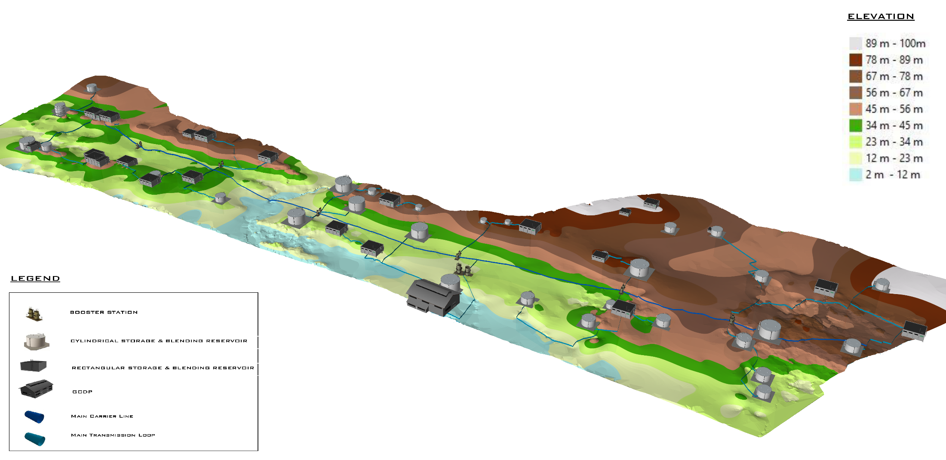
Gaza Sustainable Development and Demographic Growth , Water and Energy workshop
Gaza
31 January 2019

Slide 2
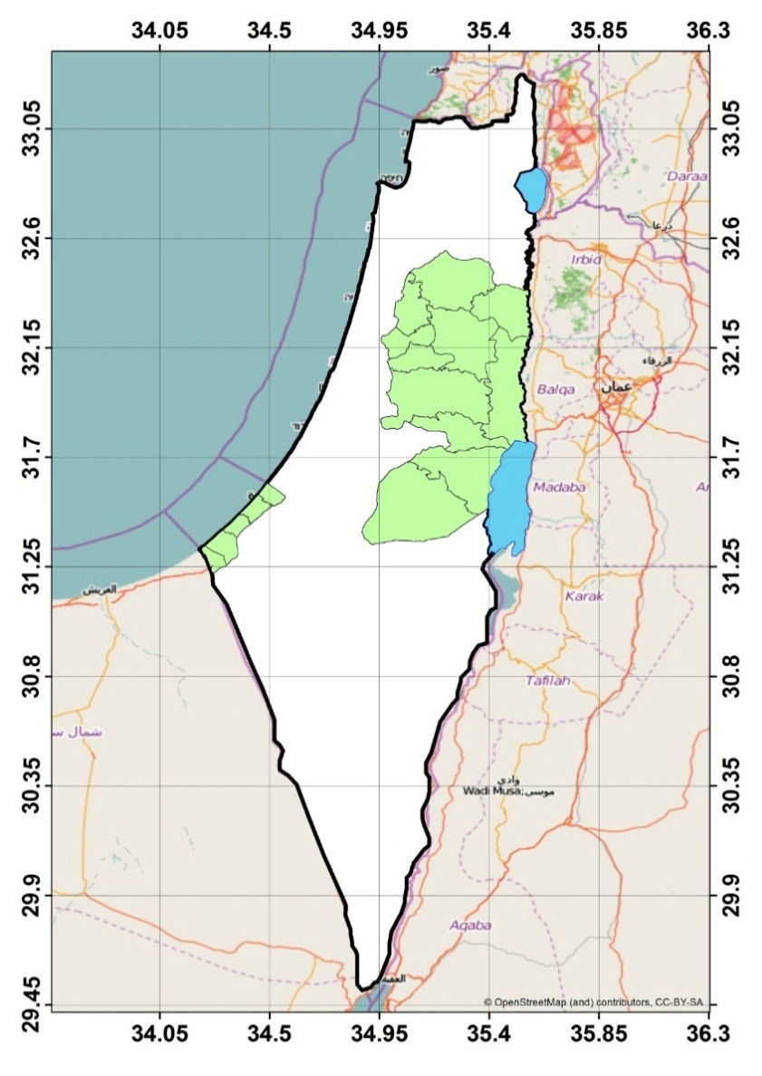
WATER CRISES IN GAZA
Gaza Strip - the most densely populated place on the planet (2 million inhabitants in 364 Km²), cut-off from the world, is at a crises point with an unprecedented human disaster about to unravel.
The sole natural water source is the coastal aquifer which suffers from annual deficit of around 120 MCM.
Mediterranean Sea
West Bank
Gaza Strip

Slide 3
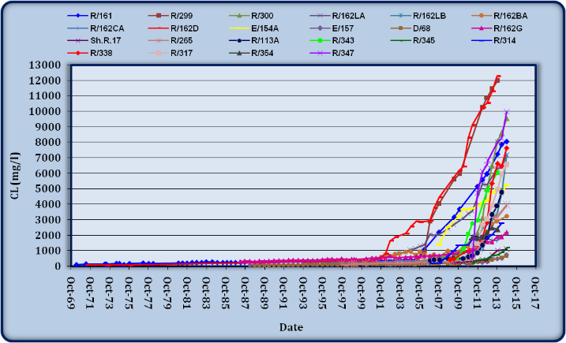
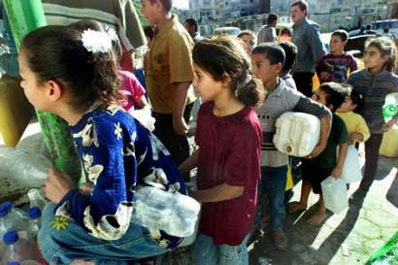
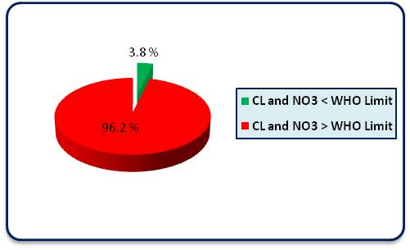
WATER CRISES IN GAZA
Up to 97% of Coastal aquifer water does not comply with WHO safe drinking limits (Chloride and Nitrate).
THE COMMUNITY IS SUFFERING BAD QUALITY WATER

Slide 4
Gaza Strip – Global Average Water Demand Envisaged
 | National Water Policy and Strategy - 2013 |  |  |  | PCBS
Year | Domestic (lcd) | Non-domestic (% of domestic) | NRW (%) | Total (lcd) | Population | Water Production (MCM/Yr)
2023 | 104 | 4.3% | 31% | 157 | 2,129,796 | 122.96
2025 | 110 | 5.7% | 26% | 156 | 2,440,765 | 139.04
2030 | 120 | 7% | 20% | 161 | 2,738,234 | 160.41
2035 | 120 | 7% | 20% | 161 | 3,044,045 | 178.45

Slide 5
PWA STRATEGY
2025 Horizon
Rainfall/ Lateral Flow
Agriculture
_{12 MCM}
Imported
20 MCM
Groundwater
Residential
_{68 MCM}
_{48 MCM}
Recovery and Reuse
_{66 MCM}
_{134 MCM}
Treatment
(WW Reuse)
Desalination
Sea
This over abstraction shall be reduced through two main alternatives (Wastewater reuse and Desalination).

Slide 6
Water Contribution from each source in MCM/year
Year | Total Water Production (MCM/y) | Mekorot (MCM/y) | STLV (MCM/y) | GCDP (MCM/y) | Groundwater (MCM/y)
2023 | 122.96 | 20,00 | 13,14 | 55,00 | 34.82
2025 | 139.04 | 20,00 | 13,14 | 55,00 | 50.90
2030 | 160.41 | 20,00 | 13,14 | 110,00 | 17.27
2035 | 178.45 | 20,00 | 13,14 | 110,00 | 35.31

Slide 7
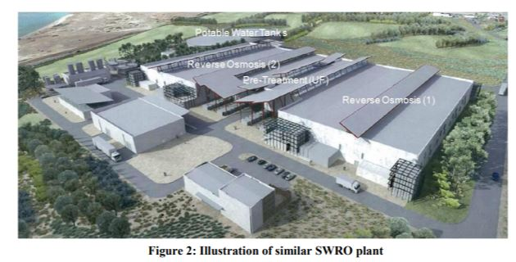
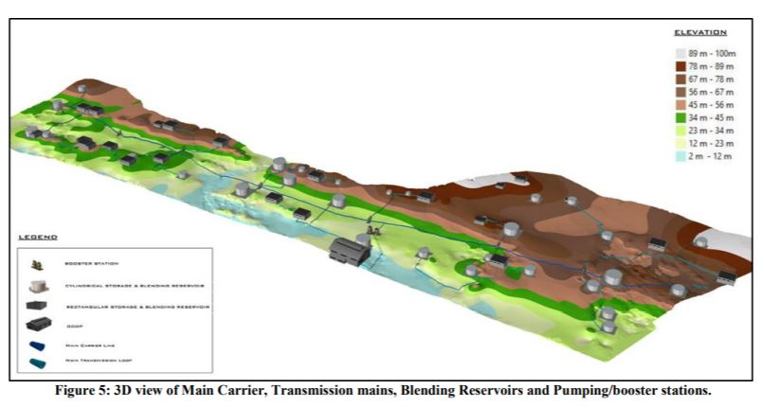
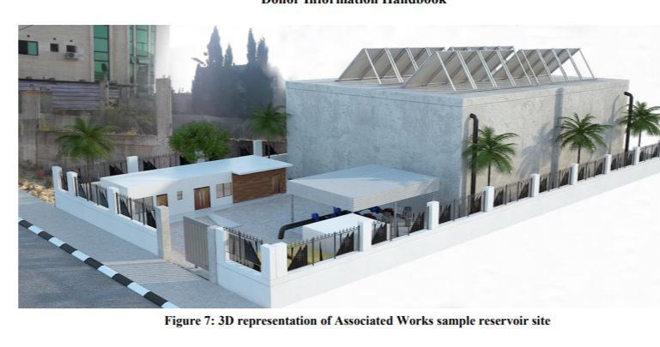
PROPOSED SOLUTION
Construction of
seawater desalination plant with an initial capacity of 55 million m³ (up to 110 M m³)
GCDP
Construction and development of
North-South carrier conveyance system that allows the distribution of fresh water throughout the Gaza Strip
Associated Works
Implementation of
non-revenue water reduction component to enhance efficiency system-wide and reduce water losses
NRW

Slide 8

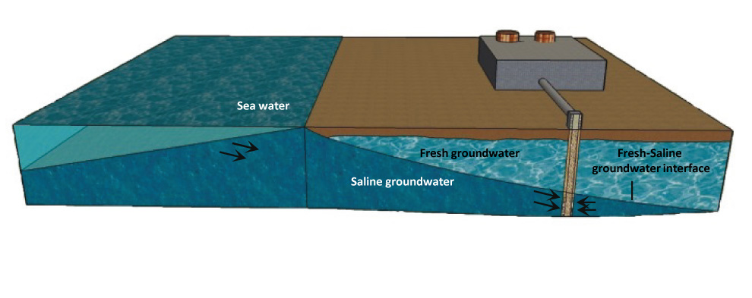


EXPECTED RESULTS
More than 2 million women, children and men will have adequate fresh water to drink and use- 55MCM/Y Avg of 110 LPCD
Contribute to the regeneration of the coastal aquifer, which is the only natural source of water in Gaza
Reduction of pollution in the Eastern Mediterranean
Job creation through the opportunities for development provided by water security

Slide 9
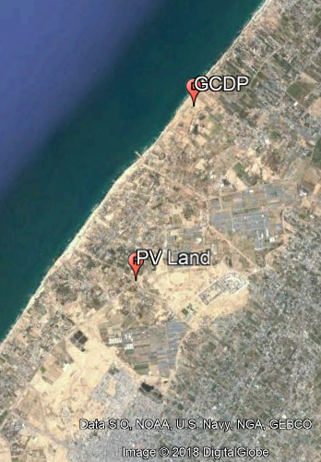
GCDP Project Data
Location : South West Dear Al Balah
Area : 8 Hectares
Capacity : 55MCM/year
Components: sea water intake structure, primary treatment facilities ,Reverse Osmoses process facilities , post treatment facilities , brine discharge and powers supply.
Onsite power supply
Off site renewable energy

Slide 10
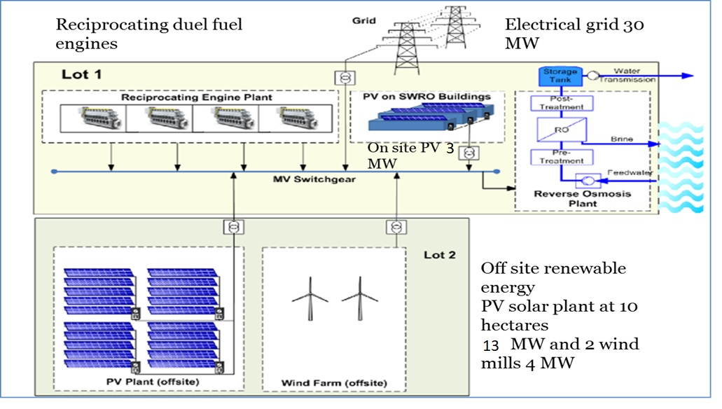
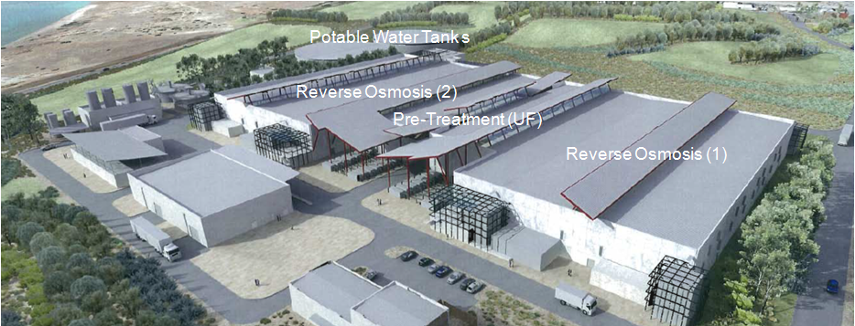

Power Supply options

Slide 11
GCDP Energy Requirements
The total power demand of the SWRO plant is in the range of 25 MWe, resulting in a total energy demand of 204 GWh per year.
The construction of an on-site fossil plant with reciprocating engines with about 34 MWe will enable a 100% coverage also in case one engine would be out of operation.
A PV plant on the roof of the SWRO buildings will have a total peak power output of about 2.8 MWe and will produce about 4.6 GWh per year, which corresponds to 2.2% of the total energy demand.
The construction on an off-site PV plant will produce about 13 MWe (peak output) and 21 GWH per year, which corresponds to 10.3% of the total energy demand.
In addition, the construction of two wind turbines with a capacity of 4 MW will produce about 5.4 GWh per year, which corresponds to 2.6% of the total energy demand.
The total energy share of renewable sources is about 15% as an average per year.

Slide 12
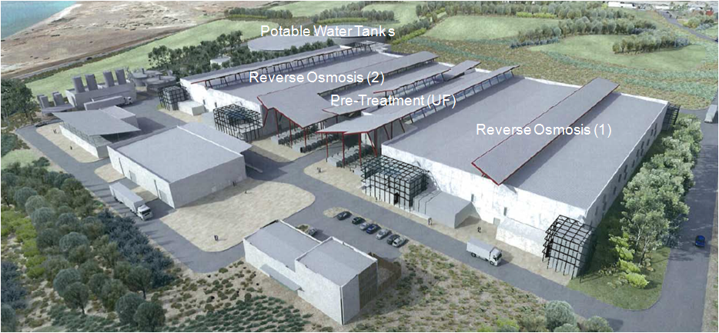
GCDP Project Data

Slide 13

Associated Works Overview

Slide 14
Division in Contract Packages
Pack. | Description |  | TD – Expected Issuing date |  | Start of Construction - Expected Date | End of Construction - Expected Date
1 | AWSNI Works - Middle + Khan Younis |  | September 2018 |  | April 2019 | June 2020
2 | CP1: Southern Main Carrier System (Rafah+Khan Younis) |  | August 2018 |  | July 2019 | Sept 2021
3 | AWSNI Works - Gaza City |  | August 2019 |  | November 2019 | January 2021
4 | CP2: North Main Carrier System (Middle, Gaza & North Gov.) |  | (Subject to funds available)
5 | CP3: WD Network Reconfiguration - Southern Area |  | June 2019 |  | October 2019 | Sept 2021
6 | CP4: WD Network Reconfiguration - (Middle, Gaza & North Gov.) |  | (Subject to funds available)

Slide 15
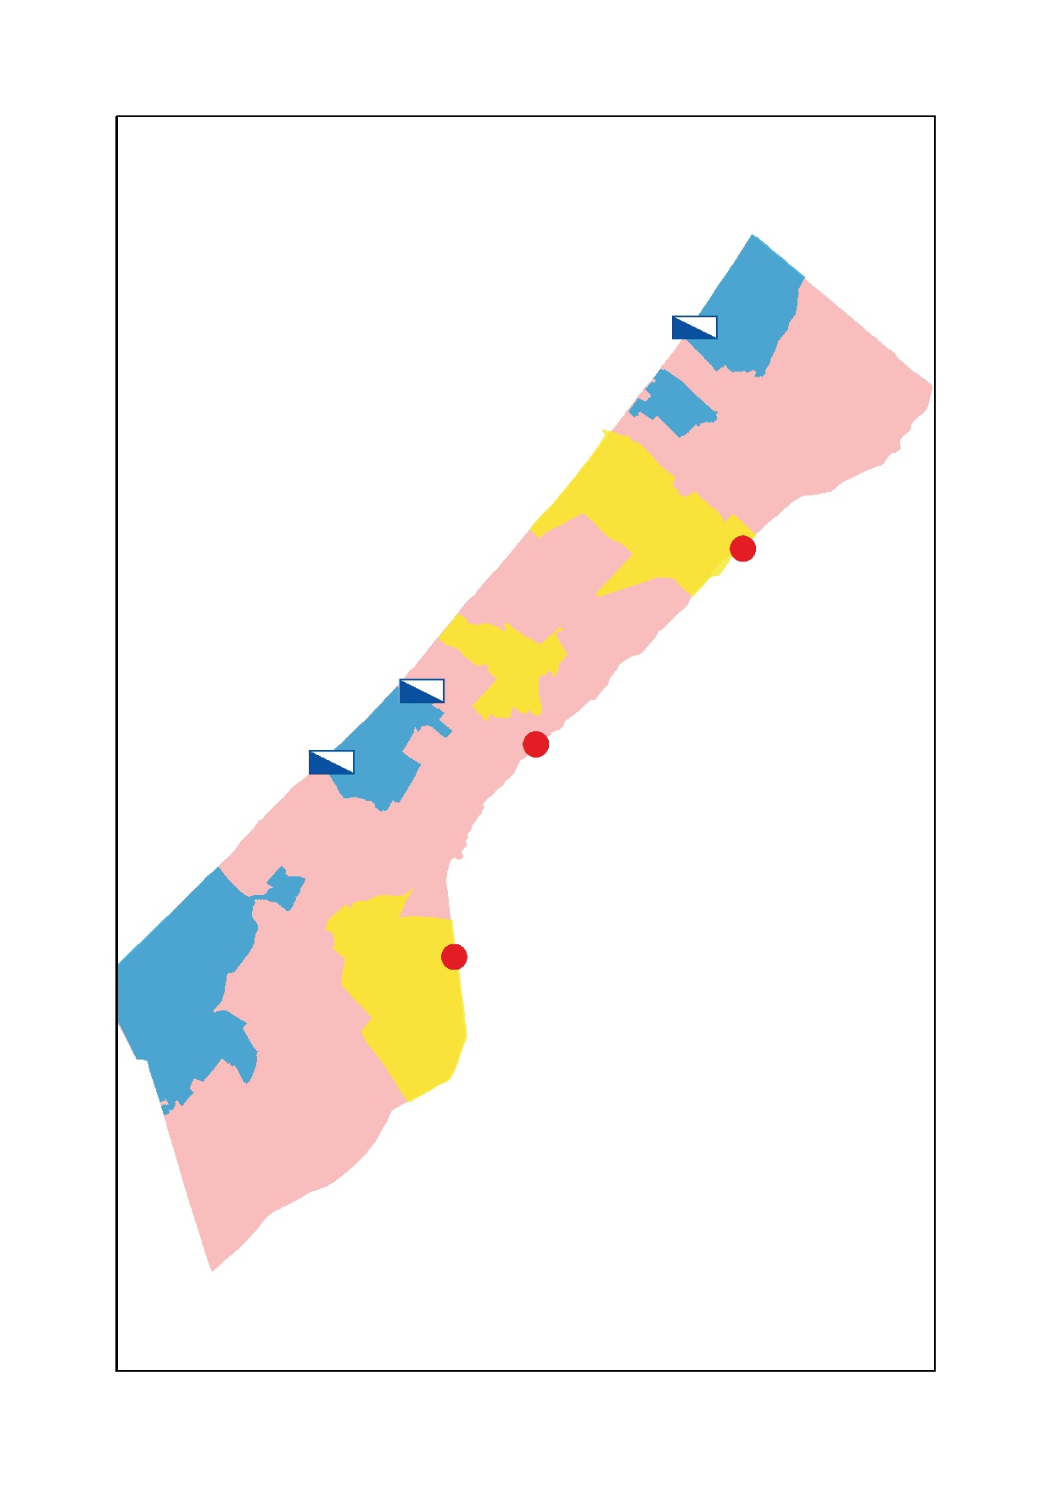
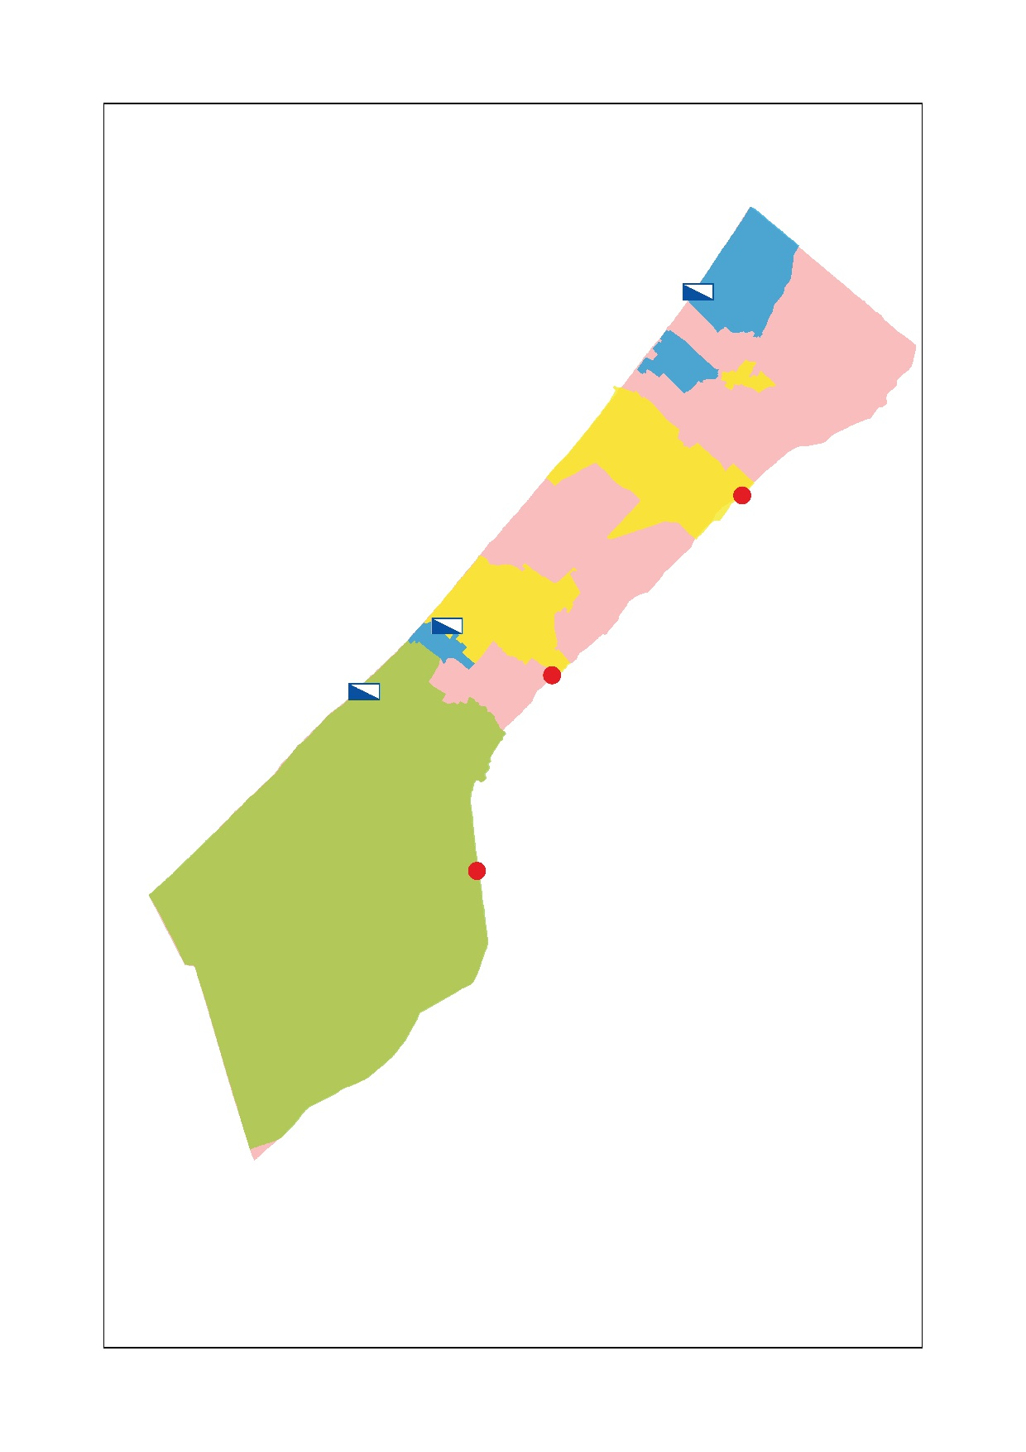
Overview of Gaza Strip – Comparison Ex Ante – Ex Post
Fresh Water Sources:
STLV: 13.14 MCM/y
From Israel: 10 MCM/y
Gaza City
Middle Area
Northern Area
Rafah
All the concerned areas in Gaza Strip
Population served:950.000 inhabitants
AV. Water Consumption: 65 lcd
Supplying Efficiency :6 h/day – 3 d/week
Av. Water Quality: CL conc.400÷800mg/l
Blending Efficiency : mixed in the WDN
Khan Younis
Eastern Villages
Middle-K.Younis-Rafah Governorates
Population served: 850.000 inhabitants
AV. Water Consumption: 70 lcd
Supplying Efficiency: 12h/day –7 d/week
Av. Water Quality: CL conc. <400 mg/l
Blending Efficiency: Partially Blended in Reservoirs
Northern Area
Middle Area
Rafah
Khan Younis
Gaza and Northern Governorates
Population served: 400.000 inhabitants
AV. Water Consumption: 65 lcd
Supplying Efficiency :6 h/day – 3 d/week
Av. Water Quality: CL conc.400÷600mg/l
Blending Efficiency : mixed in the WDN
Fresh Water Sources:
STLV: 13.14 MCM/y
From Israel: 15 MCM/y
Eastern Villages

Slide 16
Blended Water Quality Trend Comparison – CL Conc. (mg/l)
Middle, Rafah and Khan Younis Governorates
Quality Trend after implementation of Southern Carrier Components
Quality Trend without implementation of Southern Carrier Components

Slide 17
BULK WATER – ANNUAL REV. & EXP. STATEMENTS
(current prices)
Component | Unit |  | 2023 |  | 2025 | 2030
Bulk Water Sales | MCM |  | 129 |  | 139 | 160
Unified Bulk Water Charge Option 1 - FCR (1) Option 2 – OR (2) | US$/m3 US$/m3 |  | 1.03 0.87 |  | 0.81 0.66 | 1.05 0.88
Income & Expenditure Statement
Operating Revenue Option 1 – FCR (1) Option 2 – OR (2) | US$ million US$ million |  |  | 132 112 | 112 92 | 168 142
Operating Expenses | US$ million |  |  | 112 | 92 | 142
Net Income (Surplus/Deficit) Option 1 – FCR (1) Option 2 – OR (2) | US$ million US$ million |  |  | 0 -20 | 0 -20 | 0 -27
Note: (1) FCR = full cost recovery; and (2) OR = opex recovery

Slide 18
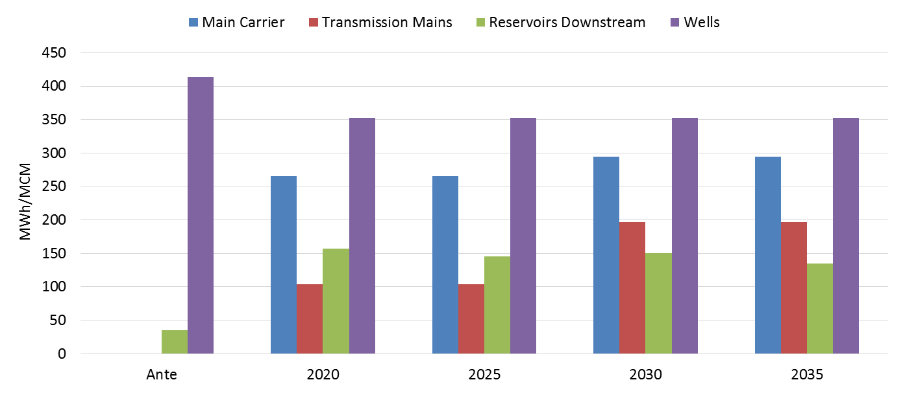
PRESENT and FUTURE SPECIFIC ENERGY CONSUMPTION

Slide 19
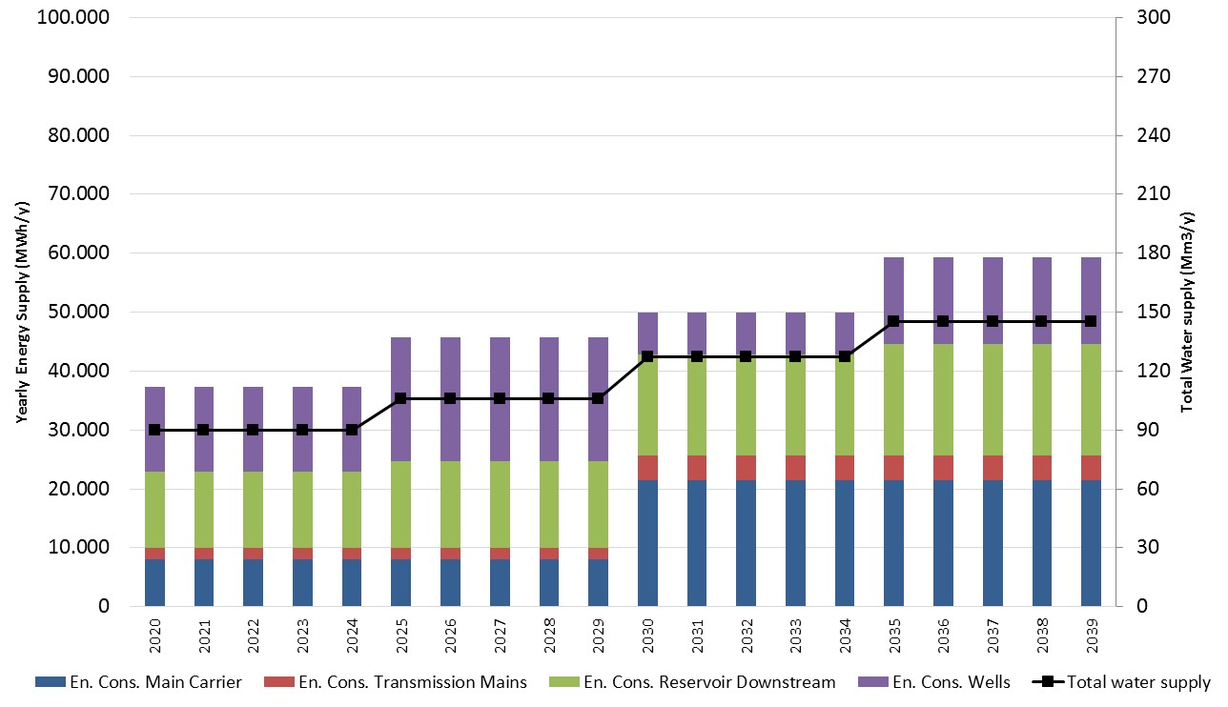
ENERGY AND WATER SUPPLY TREND IN 2020-2039

Slide 20
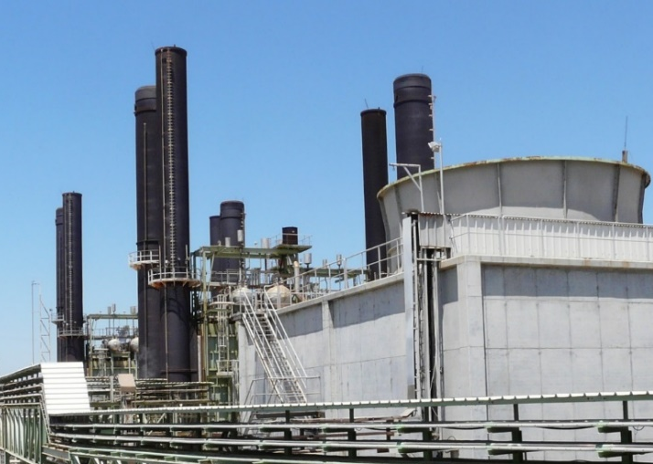
Connecting Gaza to natural gas is the central solution to the energy crisis
Gaza Power Plant
Connecting Gaza to natural gas will facilitate a significant increase in domestic electricity generation at the GPP on a cost-efficient basis
Improving the reliability and affordability of electricity for consumers
Generating substantial cost savings to the sector, even with current cost recovery challenges
Providing the foundation for sustained economic growth

Slide 21
With G4G, it is essential to meet growing demand for electricity in Gaza
796
654
675
558
582
496
517
473
Electricity Demand – Low Case
Electricity Demand – High Case
(Israel, Egypt, Renewables)

Slide 22
PROGRAM OVERALL BUDGET
Program Items | Cost (EUR)
Desalination Facility | 302.5
Desalination Plant (SWRO) | 215
Power Plant | 87.5
Reciprocating Dual Engines | 40
PV Roof | 6
PV on Ground Structure | 27.5
Wind Turbines | 8
Grid Connection | 6
Associated Works | 160
North - South Conveyor | 130
Non-Revenue Water Reduction | 30
Operation Subsidy for Five Years | 46
Consultant for Supervision | 15
Program Management Support Consultant | 6.5
Program Management Team | 5.5
Contingences (5%) | 26.8
TF Management Cost (*) | -
Total Investment | 562.3

Slide 23
THE PROJECT ARCHITECTURE
Programme Steering Committee (1)
Steering Level
International Coordination Committee (ICC) (4)
PWA (Chair), EC, EIB, IsDB, WB, other Donors , facilitated by UfMS
Management Level
PWA Chair, PM Office, including Energy, Environment, Finance, etc.
Implementation Level
Support/Coordination
Task Force
OQ (Facilitator), PWA, COGAT, EC, WB, others can attend, as required (3)
Programme Director (2)
Project Management Support Consultant ± 4 experts
Support / Coordination
GDD Secretariat
Desal Dept
//Core team Of NWC
Project Management Team
Project Management team includes experts for the desalination plant and for the associated works
( ± 8 experts in tender phase)
(± 20 in construction phase)
( ± 30 in operation phase)
Desalination Plant Project Manager
Associated Works Project Manager
Project Implementation
Consultant 1
Desalination Plant
Project Implementation
Consultant 2
Associated Works
Team Leader plus
± 30 experts on the different project phases
Team Leader plus
up to 20 experts

