Slide 1
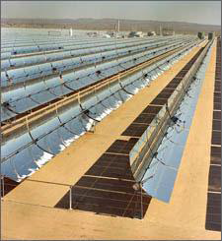


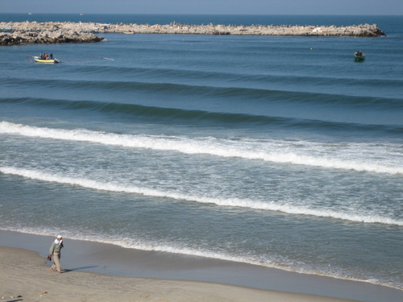
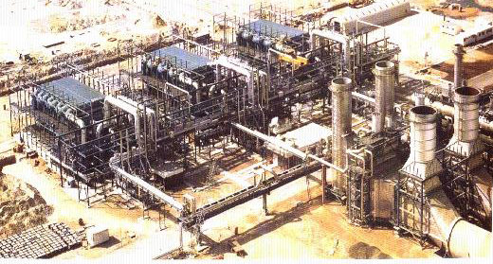
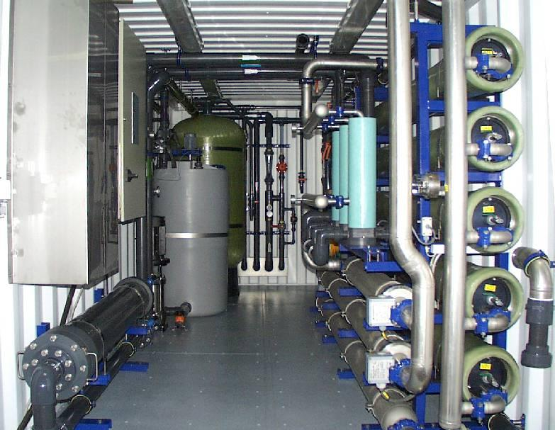
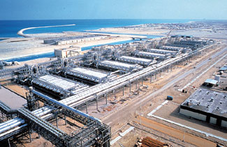


The Opportunities of Solar Energy in the Water Desalination Industry Worldwide in the Gaza strip
Presented by: Dr. Eng. Mahmoud SHATAT, (PhD, MSc, BSc)
Team Leader/ Senior Water and Sustainable Energy Specialist
Oxford Policy Management / DFID British Government consultant
Regional Middle East Organiser for WSSET

Slide 2
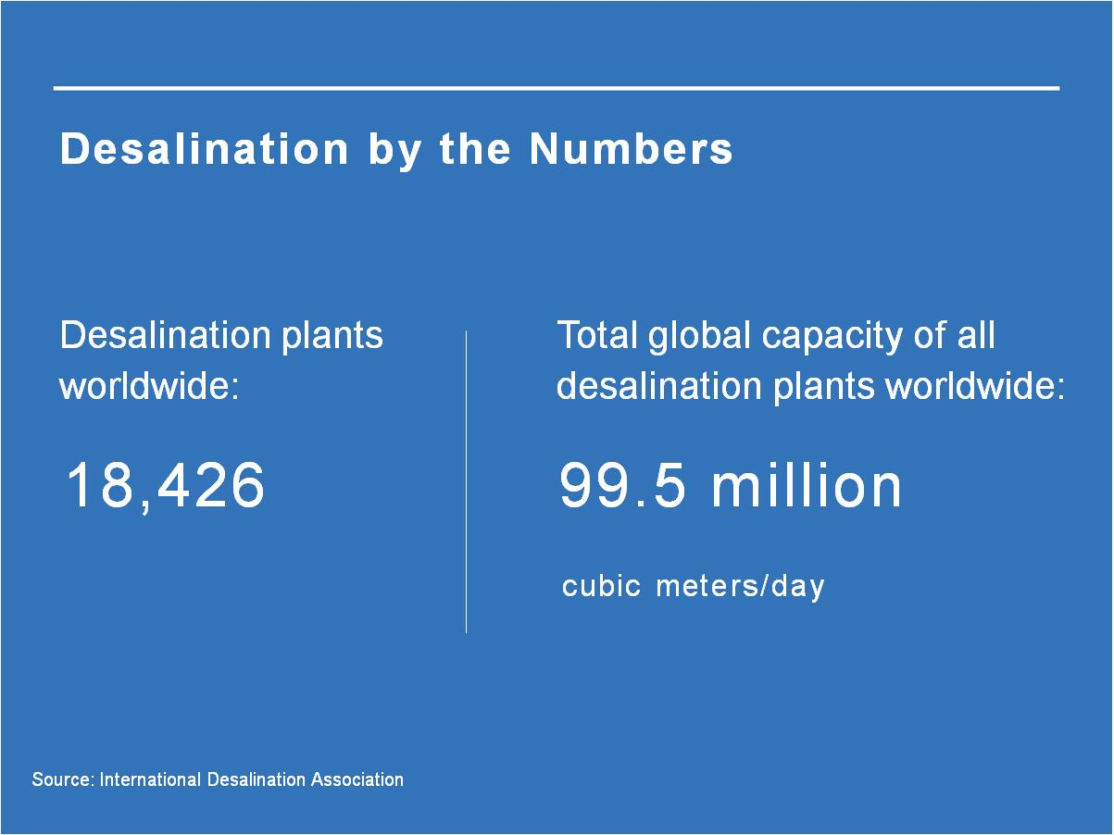
Growth of desalination market worldwide
2

Slide 3
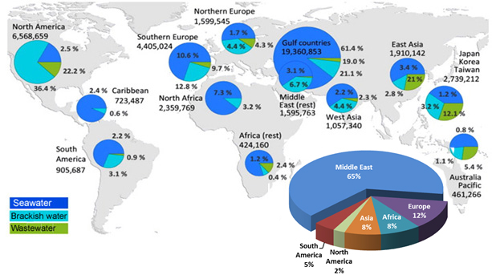
Water Desalination Worldwide
Water desalination is becoming a competitive solution to the provision of drinking water in many countries around the world
Desalination plays a crucial role in the socio-economic development.
Currently, there are more than 18,426 desalination plants worldwide (IWA). However, most of them are powered by expensive and polluting fossil fuels and current commercial desalination (mainly in the Middle East)

Slide 4
The use of renewable energy sources in water desalination
A number of different technologies allow the exploitation of renewable energy resources, providing energy as heat, power or even a combination of both energy forms.
Renewable Energy Resources
Geothermal
Solar
Wind
Solar Thermal
Electricity
PV
Heat
Electricity
Electricity
Direct Process
Indirect Process
RO
ED
MD
MSF
MED
VC
MD
RO
ED
MD
SD
HD
MSF
MED
VC
MD

Slide 5
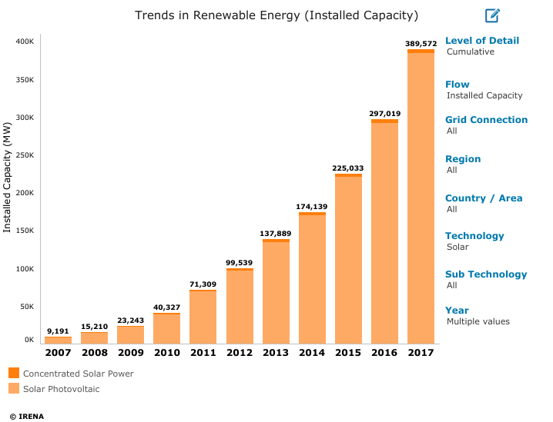
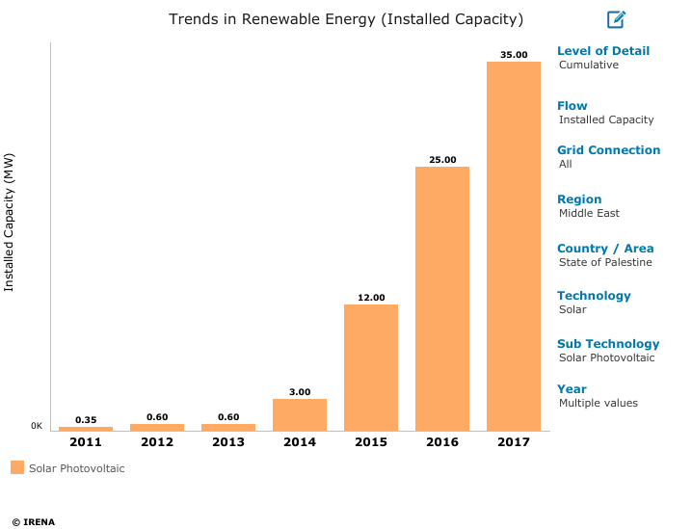
Trends in Solar Energy
Worldwide
State of Palestine
Source: International Renewable Energy Agency – IRENA - 2019

Slide 6
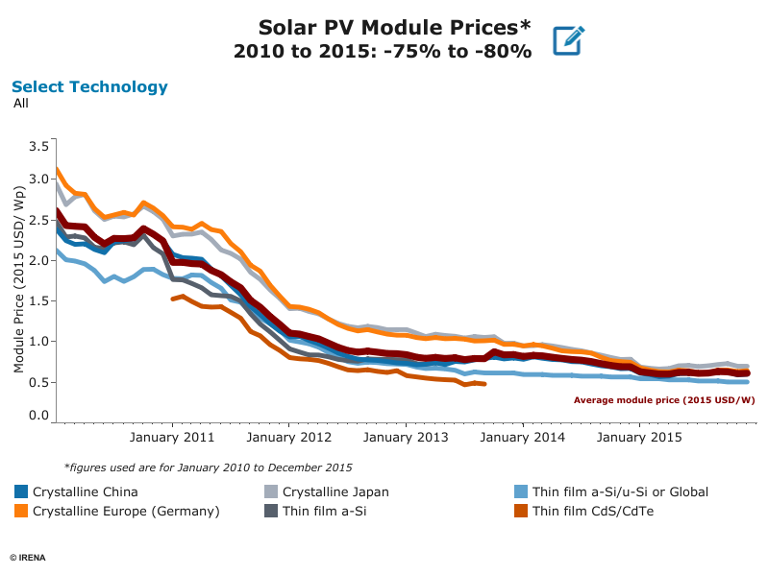
Trends in Solar Energy
Source: International Renewable Energy Agency – IRENA - 2019

Slide 7
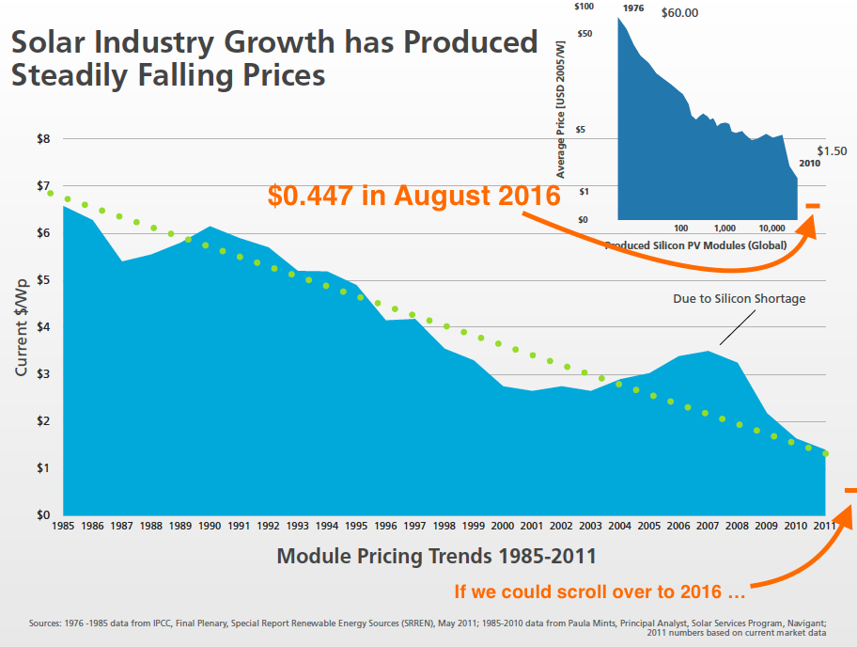
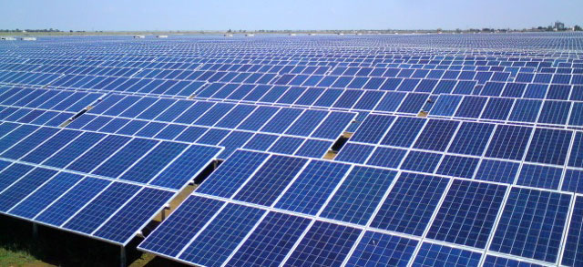
Prices of PV Solar Modules

Slide 8
Recommendations
Coupling solar energy with desalination has the potential to offer a sustainable source of energy to produce drinkable water. Furthermore, combination of solar technologies can reduce the carbon footprint of desalination.
Current desalination technologies are very energy intensive. There is a need to develop low-energy driven desalination processes, which could be integrated with solar energy
The coupling of solar energy with desalination technologies is seen as having the potential to offer a sustainable route for increasing the supplies of desalinated water. Given the solar potential of the region (daily insolation of ~5.6 kWh/m2/day which represents 2,861 mean-hours of sunshine), its proven reliability, relative simplicity of O&M as well as to be quite rapidly erected especially considering the urgency to implement the desalination projects in the Gaza strip.

Slide 9
Thank You
9

